Slide 1
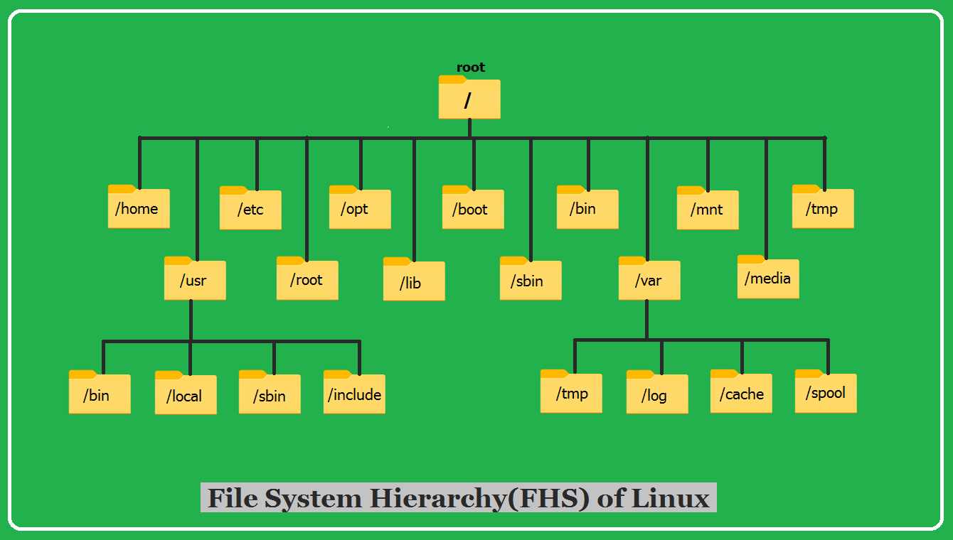

Slide 2
/root-It is home directory for root user.
/home- home directory for other user.
/boot- It contains all the boot-related information files and folders such as conf, grub, etc.
/dev - It is the location of the device files such as dev/sda1, dev/sda2, etc.
/lib - It contains kernel modules and a shared library.
/lost+found - It is used to find recovered bits of corrupted files.
/media - It contains subdirectories where removal media devices inserted.
/mnt - It contains temporary mount directories for mounting the file system.
/usr-bydefault all software are installed in this directory.
/etc-It contains all configuration files.

Slide 3
proc – It is a virtual and pseudo-file system to contains info about the running processes with a specific process ID or PID.
/run – It stores volatile runtime data.
/sbin – binary executable programs for an administrator.
/srv – It contains server-specific and server-related files.
/sys – It is a virtual filesystem for modern Linux distributions to store and allows modification of the devices connected to the system.
/bin-The '/bin' directory contains user binaries, executable files, Linux commands that are used in single user mode, and common commands that are used by all the users, like cat, cp, cd, ls, etc.

Slide 4
/boot/vmlinux – The Linux kernel file.
/dev/hda – Device file for the first IDE HDD.
/dev/hdc – A pseudo-device that output garbage output is redirected to /dev/null.
/etc/bashrc – It is used by bash shell that contains system defaults and aliases.
/etc/crontab – A shell script to run specified commands on a predefined time interval.
/etc/exports – It contains information on the file system available on the network.
/etc/fstab – Information of the Disk Drive and their mount point.
/etc/group – It is a text file to define Information of Security Group.
/etc/grub.conf – It is the grub bootloader configuration file.
/etc/init.d – Service startup Script.
/etc/lilo.conf – It contains lilo bootloader configuration file.
/etc/hosts – Information of IP and corresponding hostname

Slide 5
usr/bin – It contains most of the executable files.
/usr/bin/X11 – Symbolic link of /usr/bin.
/usr/include – It contains standard include files used by C program.
/usr/share – It contains architecture independent shareable text files.
/usr/lib – It contains object files and libraries.
/usr/sbin – It contains commands for Super User, for System Administration. /proc/cpuinfo – CPU Information
/proc/filesystems – It keeps the useful info about the processes that are running currently.
/proc/interrupts – it keeps the information about the number of interrupts per IRQ.
/proc/ioports – Contains all the Input and Output addresses used by devices on the server.
/proc/meminfo – It reports the memory usage information.
/proc/modules – Currently using kernel module.

Slide 6
/proc/mount – Mounted File-system Information.
/proc/stat – It displays the detailed statistics of the current system.
/proc/swaps – It contains swap file information.
/var/log/lastlog – It stores user last login info.
/var/log/messages – It has all the global system messages.
/var/log/wtmp – It keeps a history of login.
/sbin/cat update-passwd.
/Lib/cat os-release.
/boot/Grub/

